Slide 1


MEMEPEDIA
S.Ansar
K.Nursultan
S.Adil
Our mission is to provide your fun

Slide 2
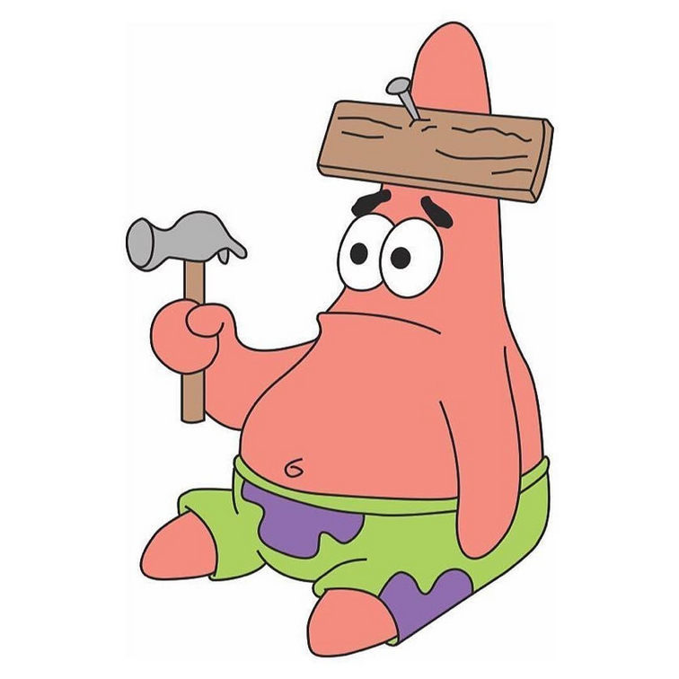
The main goal
Our main goal is to show relevant and funny memes and promote the concept of memes, in general, to make people happier

Slide 3
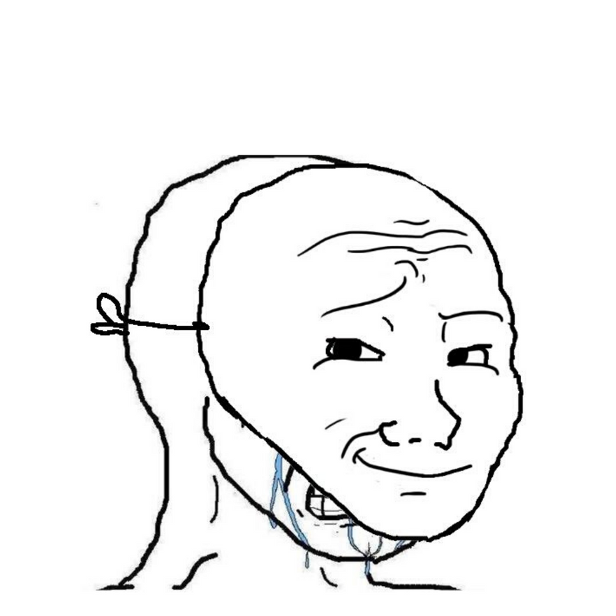
Revelance
According to Google Trends statistics memes are relevant and will be relevant for a very long time

Slide 4
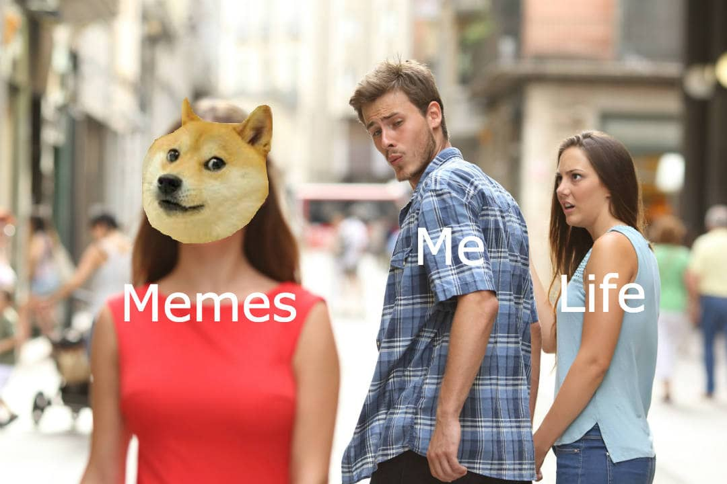
Objectives
1.Introduce more people to the world of memes.
2..Make design more user-friendly

Slide 5

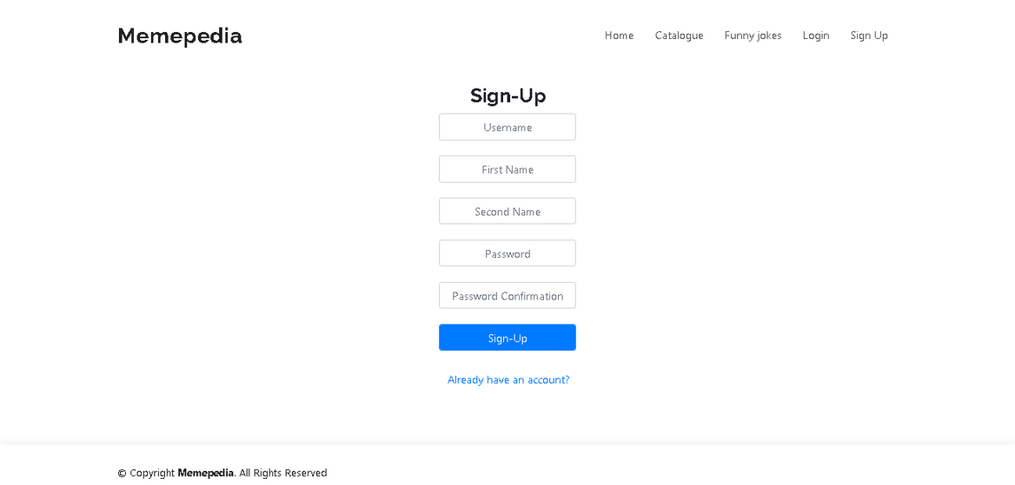
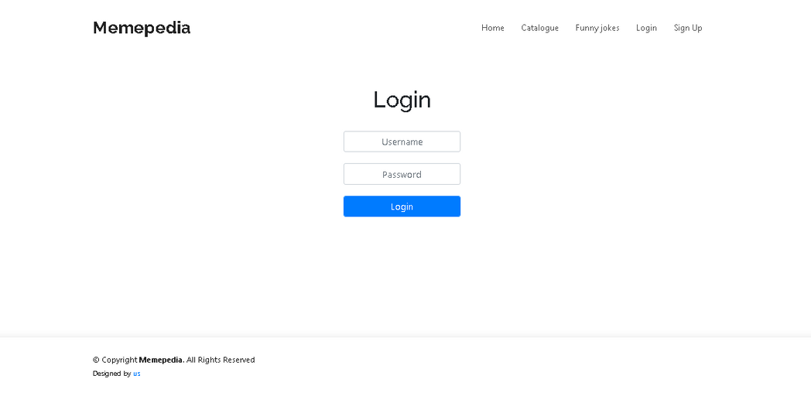
FEATURES
The website has a registration and login, you can also log out of your account,

Slide 6
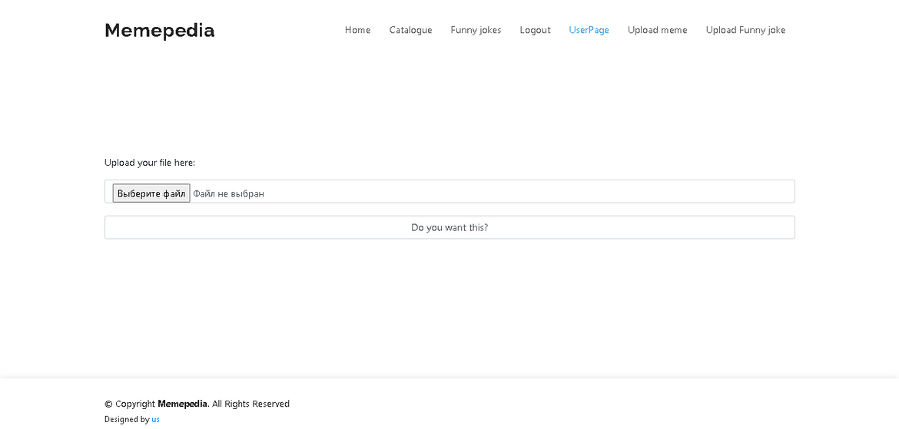
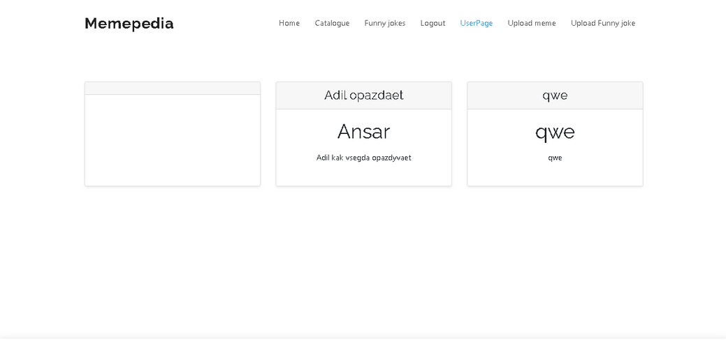
Also website has a directory with memes, you can add media files, text and view it

Slide 7
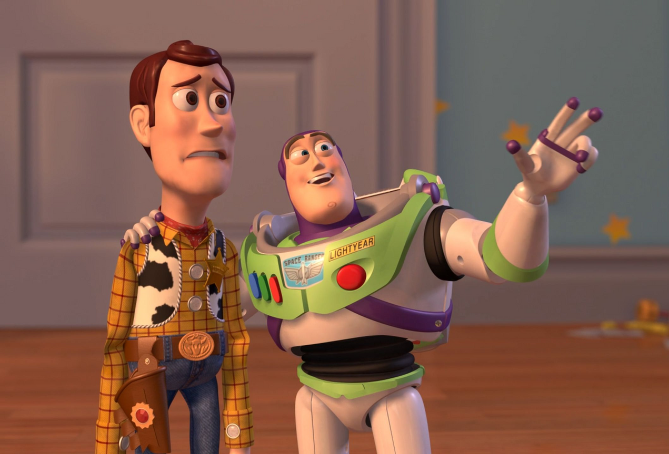
THE COMPETITOR IN MARKETPLACE SECTORS
Future development possibilities
1.Make a profit from the project
2.Mobile application development
3.Develop more convenient features(for ex:search for memes)

Slide 8
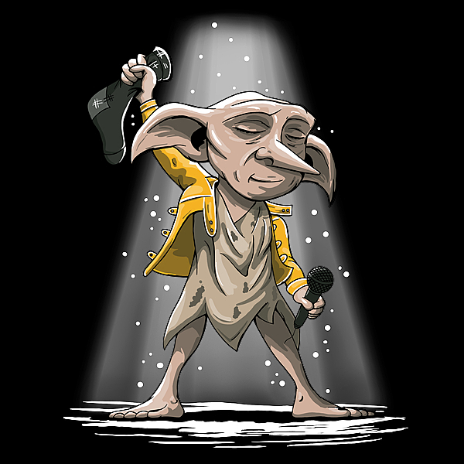
THANK YOU
Добавить основной текст

